Slide 1

HTML forms
Pavel Sucharev
1 LYGIS
2022

Slide 2
HTML forms
HTML forms
What's HTML form?
User input data and interact with the website.
The data from website is sent to the server/backend.
Forms can have multiple widgets: select boxes, buttons, checkboxes, or radio buttons.

Slide 3
HTML forms <tags>
HTML forms
<form> – parent wrapper for all form.
<label> – name for input.
<input> – to fill in data (text, number).
<textarea> – place for inputting longer text, usually a message.
<button> – an action button to send the form to the server.

Slide 4
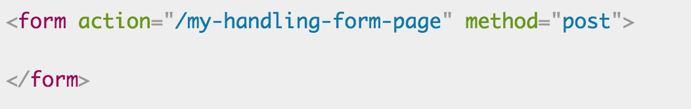
HTML forms <form>
HTML forms
<form> – all HTML forms starts with main wrapper.
Attributes:
Action: location URL, endpoint where data will be sent;
Method: defines HTTP method to send the data (POST or GET).
! Important it's strictly forbidden to nest a form into another form.

Slide 5
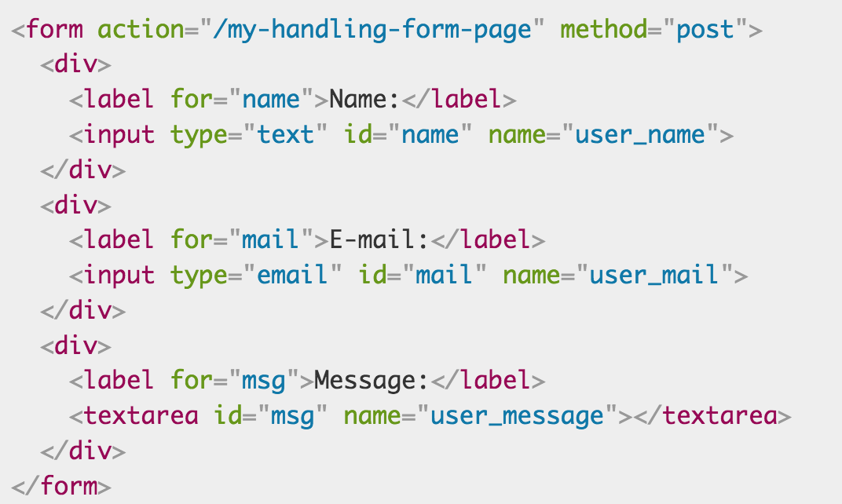
HTML contact form example
HTML forms

Slide 6
HTML contact form example
HTML forms
<div> – are used to have three different block elements that will go below each other.
<label> attribute ”for” – is used to link a <label> to a form widget (e. g. input)
<input> attribute ”type” – ! Important, it defines how input element behaves.
! Important an <input> tag doesn't need a closing tag.

Slide 7
HTML form <input>
HTML forms
<input> attribute ”type” – ! Important, it defines how input element behaves.
type="text" (accepts any kind of string)

Slide 8
HTML form <input>
HTML forms
type="email" (accepts emails)
If we want to insert several emails in input additional attribute "multiple".

Slide 9

HTML form <input>
HTML forms
type="password" (used for inputting passwords)
Accepts texts, but the characters are hidden for security reasons.

Slide 10
HTML form <input>
HTML forms
type="search" (for searching)
Usually have 'x' in the corner to clean input if incorrect search text was entered.

Slide 11

HTML form <input>
HTML forms
type="url" (for entering URL address)
Allows to submit the form if only a correct URL was entered.

Slide 12

HTML <textarea>
HTML forms
<textarea></textarea> – similar like <input>, this tag is also for inputting information, but for multiline text.
Attributes:
Rows – setting the numbers of rows of textare, describes height;
Cols – setting the cumber of columns of textarea, describes width.
! Important – style="resize: none" important if you don't want a textarea to be resizable.

Slide 13
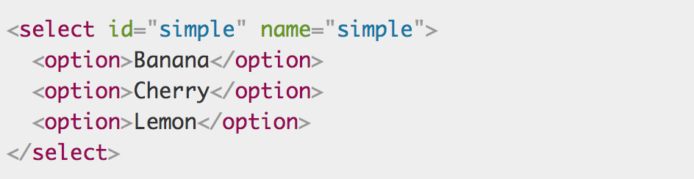
HTML forms drop-downs
HTML forms
<select> – allows user to select from several options.
<option>

Slide 14
HTML forms drop-downs
HTML forms
<select> – main wrapper.
<option> – children of select.
Allows client to select one option from several possible.

Slide 15
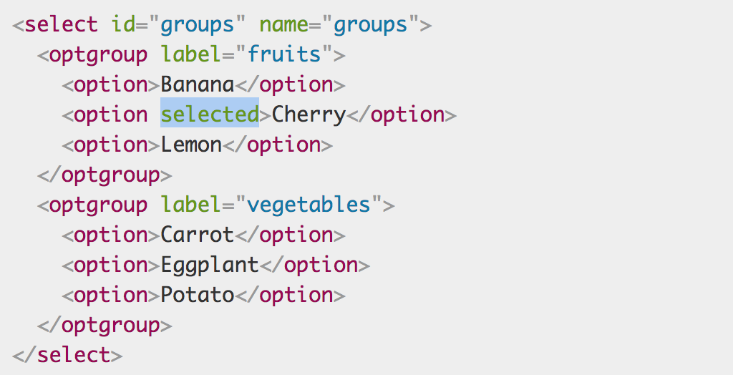
HTML forms drop-downs
HTML forms
<optgroup> – to set different selection groups.
Attribute [selected] – to preselect a value.
Attribute [multiple] – to select several options, goes in <select> tag.

Slide 16
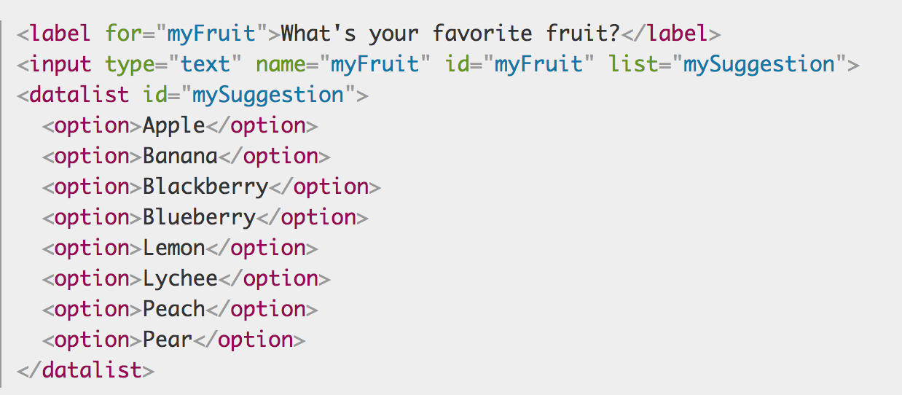
HTML forms drop-downs <datalist> new!
HTML forms
New additional to HTML5 <datalist> tag.
Allows to show the users possible options once they start typing input text.
Not fully supported in all browsers.

Slide 17
HTML forms checkable items
HTML forms
Radio buttons.
Check boxes.
! Important if checkable item is not checked and form is submitted nothing is sent to the server, compared to the simple input, where we always send the input name at least.

Slide 18
HTML form checkbox
HTML forms
To make a checkbox input, type="checkbox" must be provided.

Slide 19

HTML form radio button
HTML forms
To make a radio button, type="radio" must be provided.
! Important If several radio button inputs has the same [name] attribute, only one checkbox can be marked.

Slide 20
HTML form Numbers
HTML forms
type="number", for creating an <input> that accepts only the numbers.
Constraining the value with attributes [min], [max].
Stepper [step] – change value by 1 or 2, or 3.

Slide 21
HTML form Slider
HTML forms
type="range", allows to create a slider, when exact value is not important.

Slide 22



HTML form data and time picker
HTML forms
type=“datetime-local", type="month", type="time", type="week"

Slide 23

HTML form Color picker
HTML forms
a color widget allows user to pick up a color, type="color"

Slide 24
HTML form file picker
HTML forms
a color widget allows user to upload files, type="file"

Slide 25

HTML form progress bar
HTML forms
a progress bar widget allows user to see the progress.
<progress></progress>
Setting [max], [min] as percentage.

Slide 26
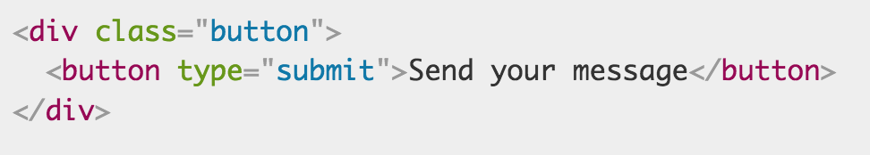
HTML <button></button>
HTML forms
Allows for the client to SEND data to the server.
Accepts 3 types:
Submit – for submitting a form, sending data;
Reset – resets all forms inputs;
Button – does nothing!

Slide 27
HTML <label>
HTML forms
<label> is clickable if attribute for="name" has the same value as <input> id="name"
Example:

Slide 28
HTML default values for <input> and <textarea>
HTML forms
<textarea></textarea> – to set default value as child text.
<input> – to set attribute value="default text"

Slide 29
HTML default values with placeholder
HTML forms
<textarea></textarea> – accepts attribute "placeholder" to set initial value.
<input> – accepts attribute "placeholder" to set initial value.
Try it out!

Slide 30
HTML form attributes
HTML forms
Common attributes for all form's widgets:
Autofocus – sets the input or other widget as starting point, on page reload;
Disabled – sets the widget disabled, if we want to prevent client entering the data;
Required – is this attribute is set we must enter data in input.

Slide 31
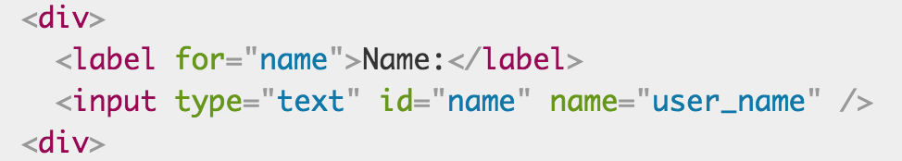
HTML sending forms
HTML forms
In addition, every form's <input> has to include "name" attribute.
"name" describes for the browser which name to give for each data.
"name" for server describes what's data name.

Slide 32
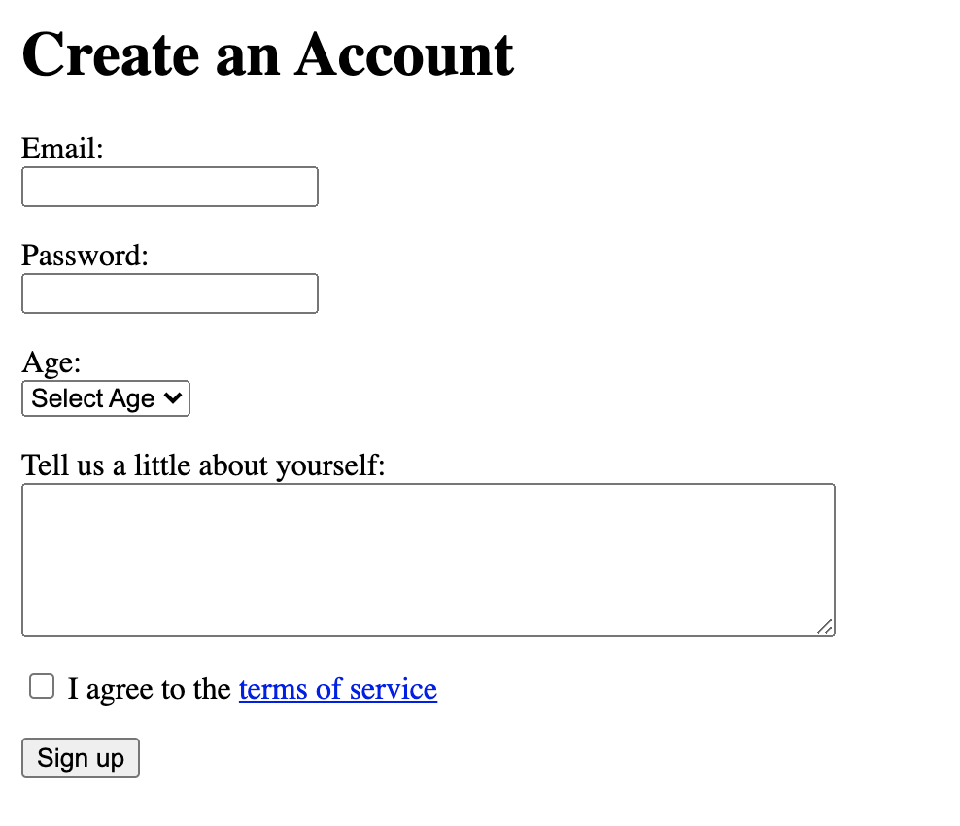
<Užduotis>
HTML forms

Slide 33
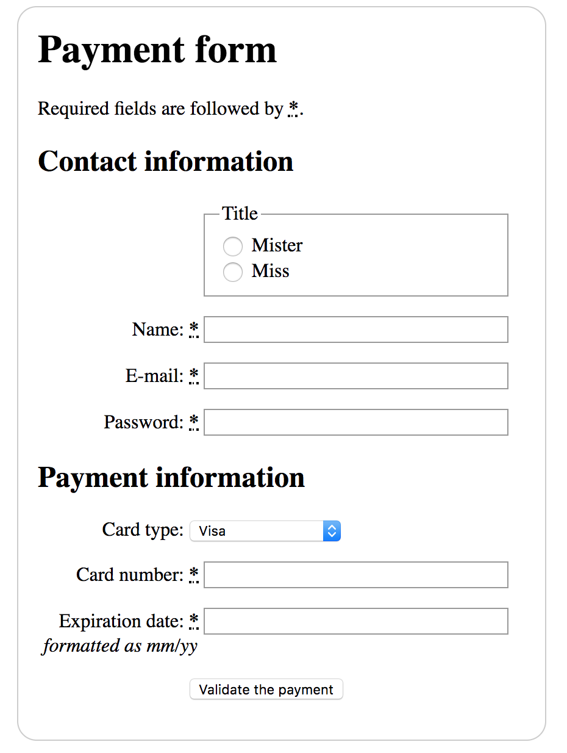
<Užduotis>
HTML forms
Building a form
New widgets:
<abbr> – abbreviation;
<fieldset> – grouping related elements;
<legend> – defines a title of the fieldset.

Slide 34
Naudinga informacija
CSS
w3schools
https://www.w3schools.com/html/html_forms.asp
Formspree
https://formspree.io/
Formspree youtube tutorial
https://www.youtube.com/watch?v=H_MUJ--iAcc

